Slide 1
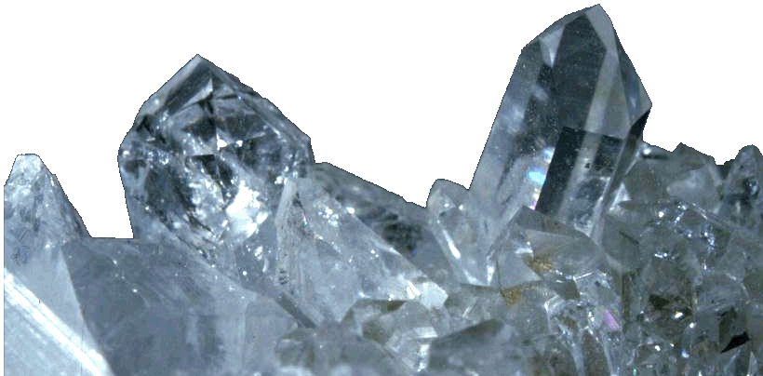
Rocks and Minerals

Slide 2
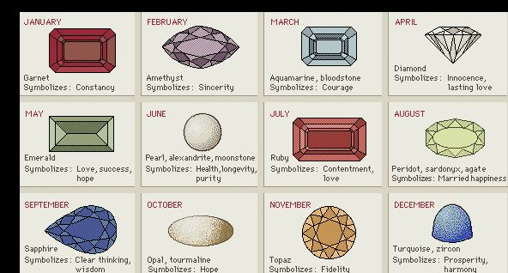

Slide 3
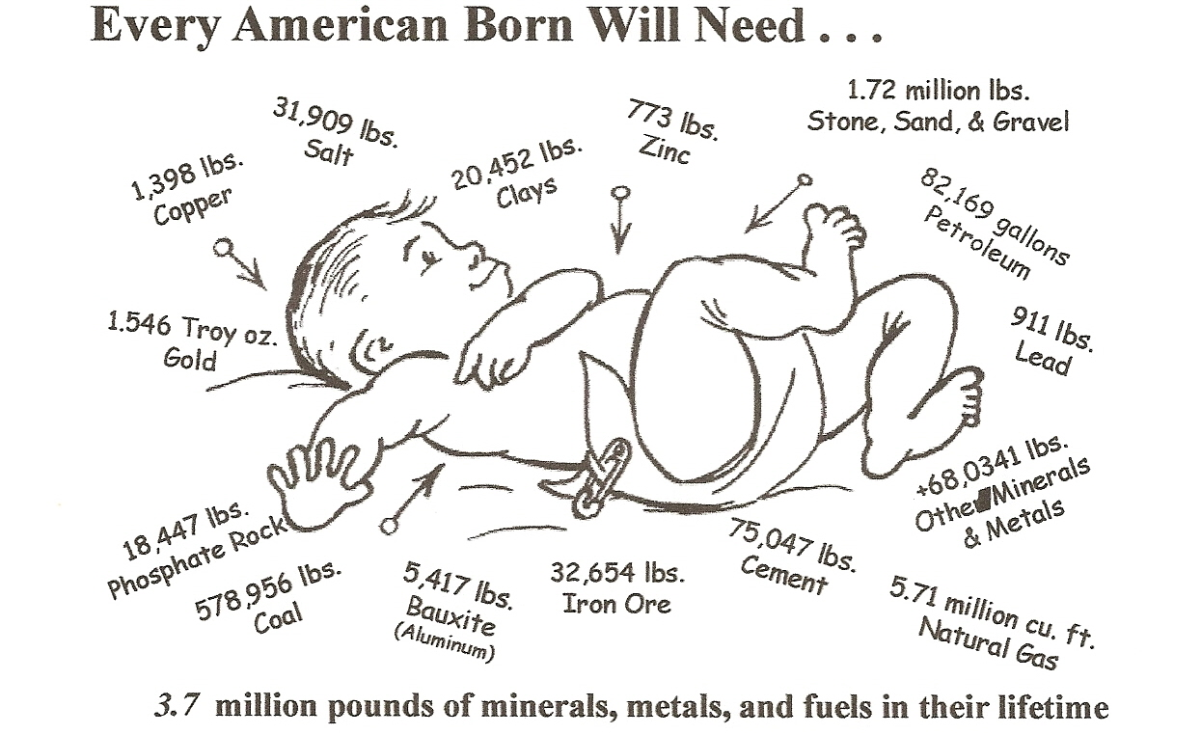

Slide 4
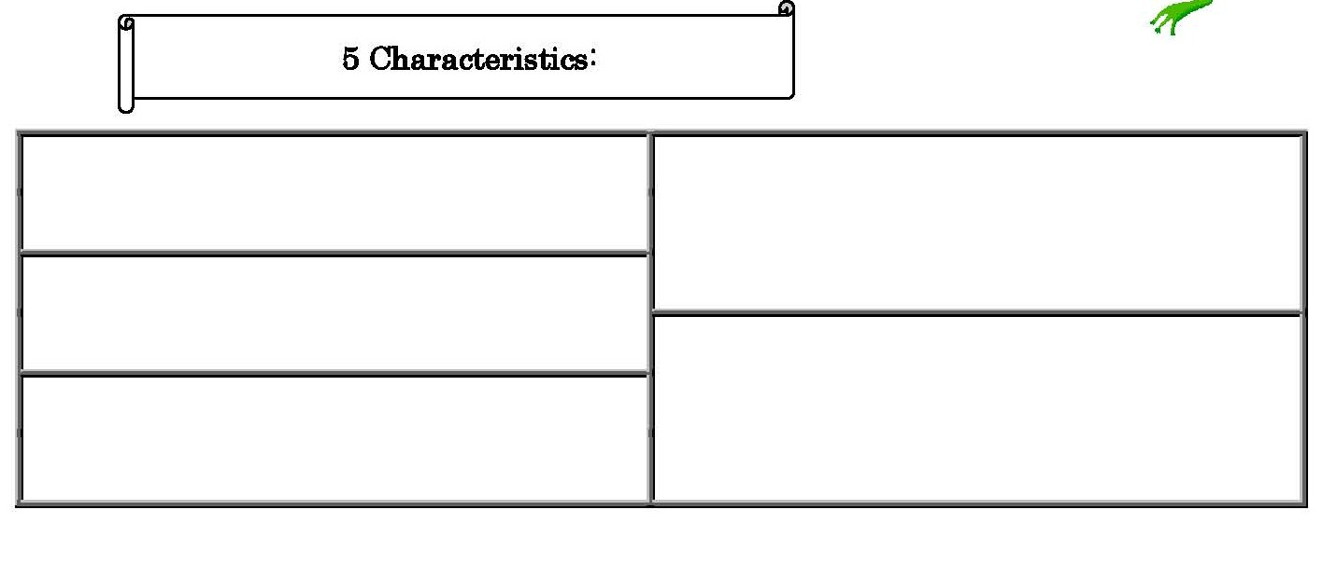
Minerals
Naturally Occurring
Formed from elements or compounds
Inorganic
Definite chemical make up and regular atomic structure
Found as a solid in nature

Slide 5
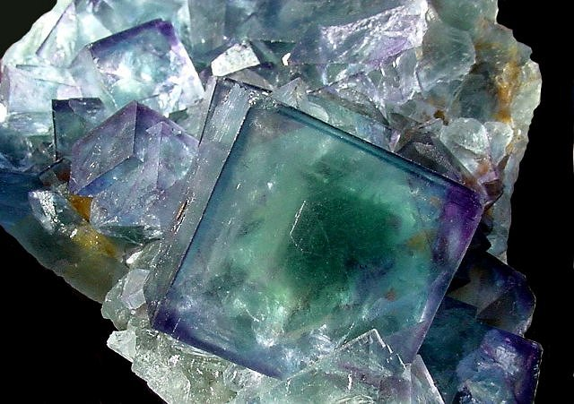
physical
chemical
These are
Luster
Hardness
Cleavage
Color
Composition

Slide 6
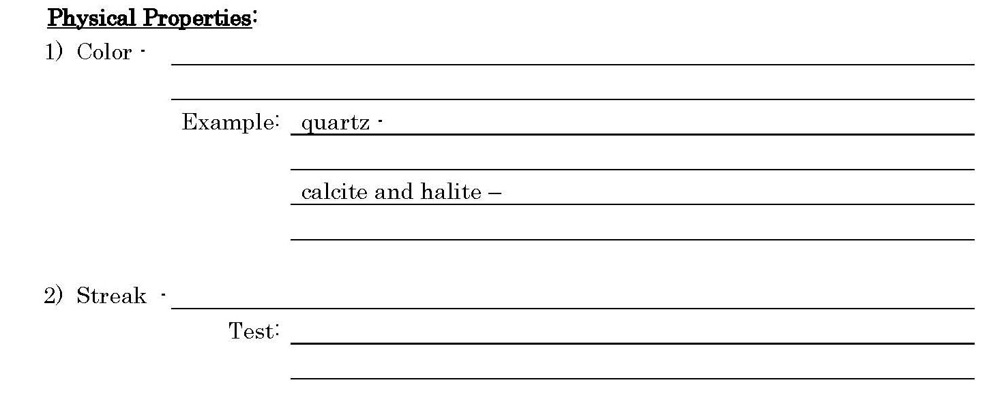
- Easiest to recognize
*The worst property for mineral ID* because,
Comes in many different colors
Can be transparent along with many others

Slide 7
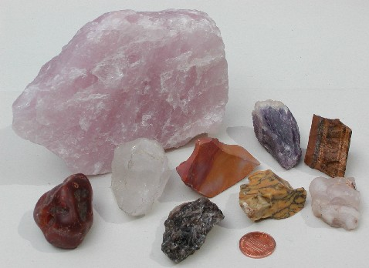
Different samples of Quartz

Slide 8
*The worst property for mineral ID*
- Easiest to recognize
Comes in many different colors
Can be transparent along with many others
The color of a minerals powder
Rub a mineral across a piece of ceramic tile

Slide 9
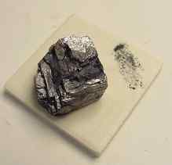
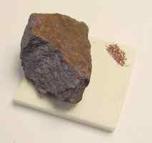
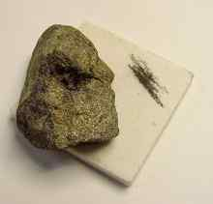
Streak

Slide 10
The way a mineral reflects light
Looks like a metal
Does not look like a metal

Slide 11
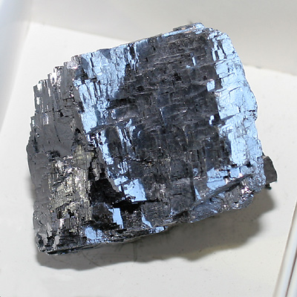
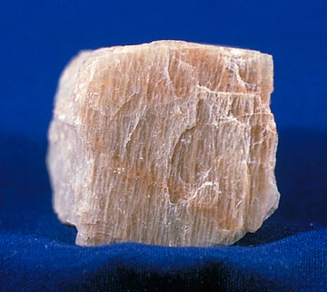
Metallic
Non-Metallic

Slide 12
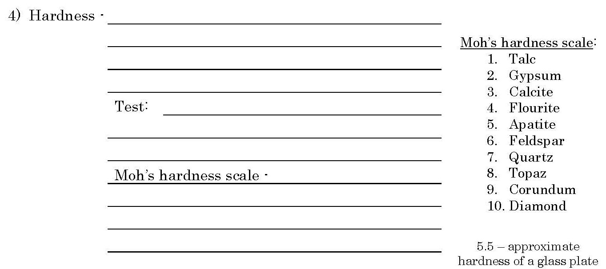
A minerals ability to scratch or be scratched
See if mineral scratches a glass plate
*If it scratches glass = its harder than glass*
10 minerals placed in order of hardness
Higher numbers scratch lower numbers

Slide 13
The ability of a mineral to break along smooth flat surfaces
Look at a mineral carefully and check if light is reflecting off flat surfaces

Slide 14
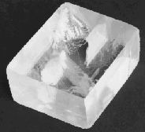
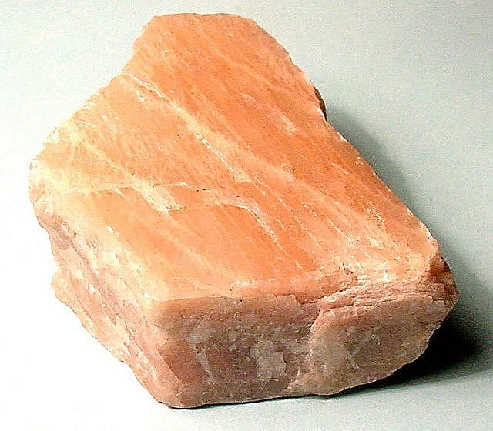
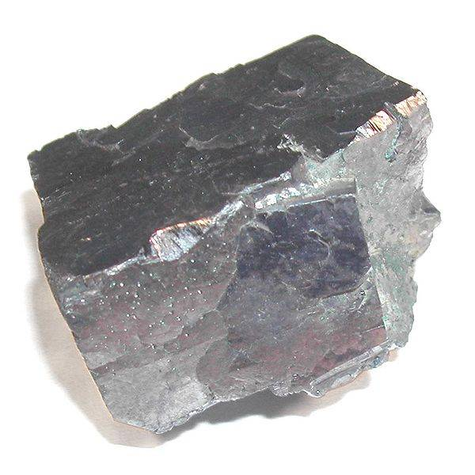
Cleavage

Slide 15
The ability of a mineral to break along smooth flat surfaces
Look at a mineral carefully and check if light is reflecting off flat surfaces
When a mineral breaks into pieces with uneven surfaces

Slide 16
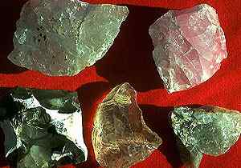
Fracture

Slide 17
Elements that make up a mineral
Quartz composition = SiO₂

Slide 18
Unique properties some minerals have
Halite = tastes salty
Calcite= bubbles with HCl (hydrochloric acid)

Slide 19
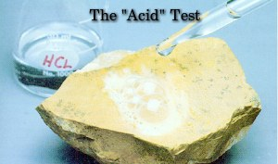

Slide 20
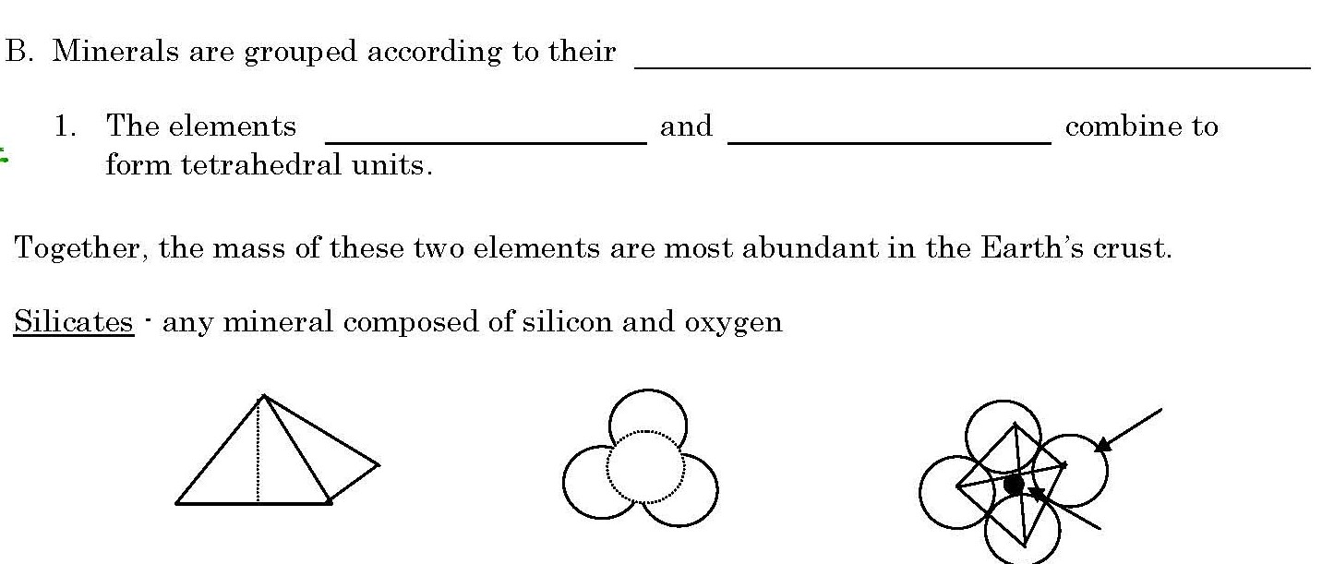
Physical and Chemical properties
silicon
oxygen

Slide 21
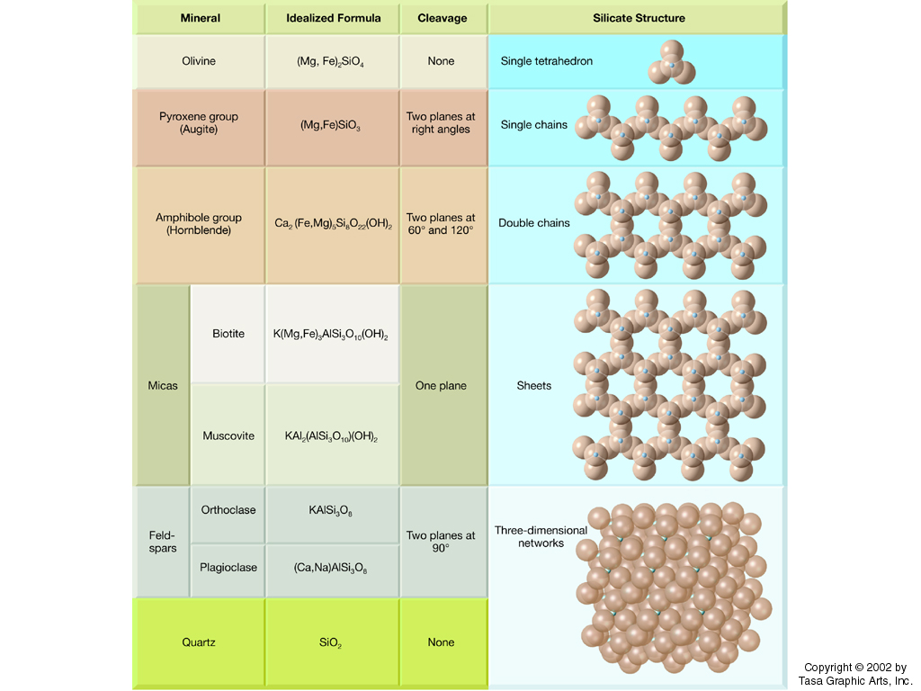

Slide 22
Internal arrangement of atoms
- jewelry
- Pencil lead
- lubricant
- Cutting hard substances

Slide 23
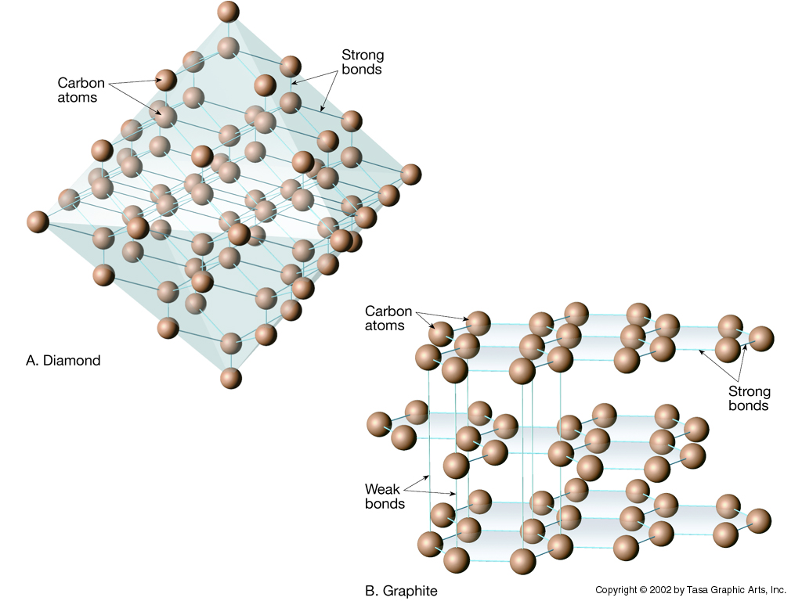

Slide 24
Everywhere
Dozen
Minerals
Building blocks
coal
limestone

Slide 25
Complete pages 6-7 in notes packet
Watch You Tube Videos 3.1, ESRT 16

Slide 26
Three Classifications
of Rocks are:
igneous
sedimentary
metamorphic

Slide 27
How are rocks identified?
By their…
1) Composition
2) Texture
Texture is not how the rock feels but the size, shape and arrangement of the materials the rock is composed of.

Slide 28
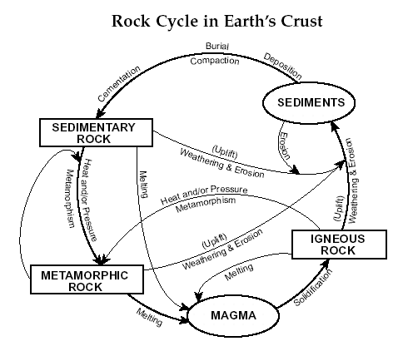

Slide 29
Sedimentary Rocks
clasts

Slide 30
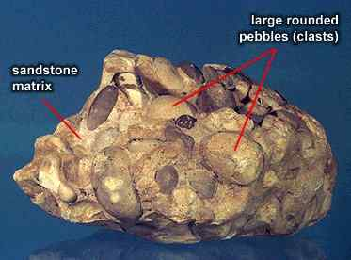

Slide 31
Sedimentary Rocks
clasts
Cementation and Compactions of rock sediments
Chemical precipitates from a solution

Slide 32
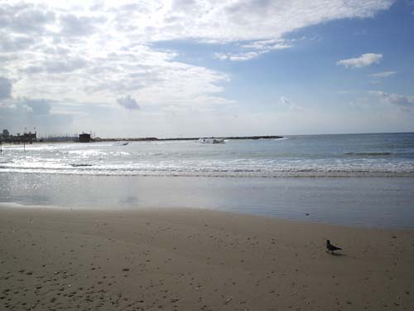
watery

Slide 33
- Clear layering of sediments
- Found in rock outcrops

Slide 34
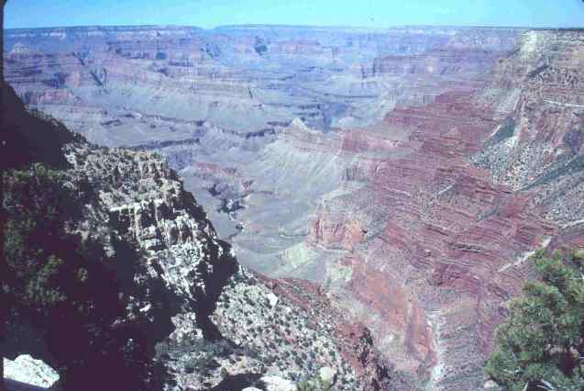

Slide 35
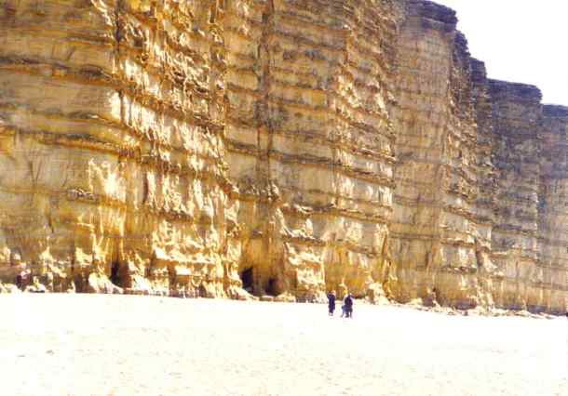

Slide 36
- Clear layering of sediments
- Found in rock outcrops
- Pieces of other rocks

Slide 37
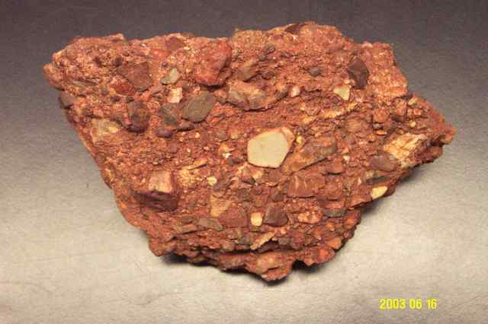

Slide 38
- Clear layering of sediments
- Found in rock outcrops
- Pieces of other rocks
- The remains of once living organisms

Slide 39
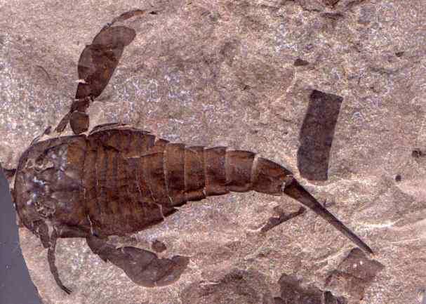

Slide 40
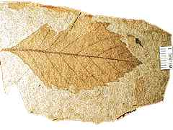
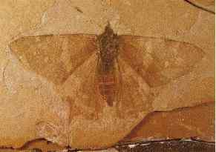
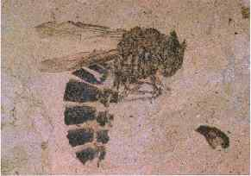

Slide 41
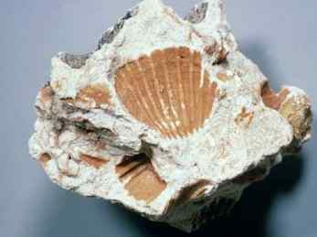
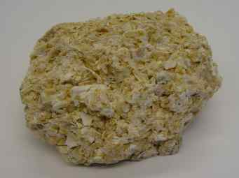

Slide 42
http://www.eram.k12.ny.us/education/sctemp/47599442ab8e5070f121df9cd8bba399/1255982708/sedimentary.swf
Animated sedimentary rocks esrt

Slide 43
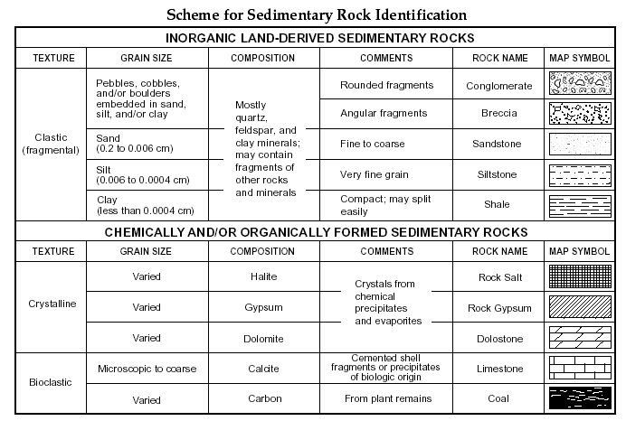

Slide 44
Complete pages 8-10 in notes packet
Watch You Tube Videos 3.2, ESRT 7a, ESRT 6a

Slide 45
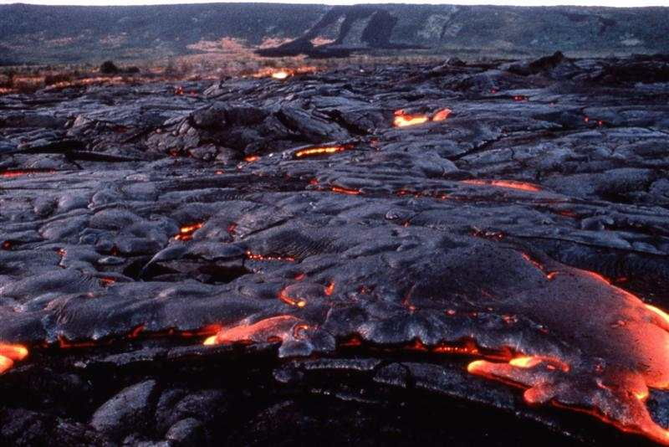
Igneous Rocks

Slide 47
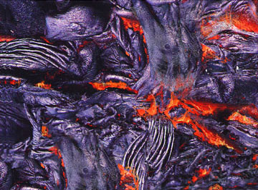
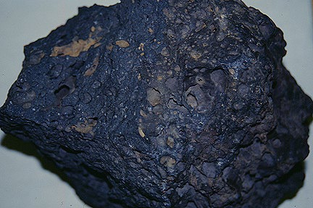
Forms from the solidification of molten material (magma)

Slide 48
Plutonic (inside the earth)
Slow to very slow
Large
Coarse to very coarse

Slide 49
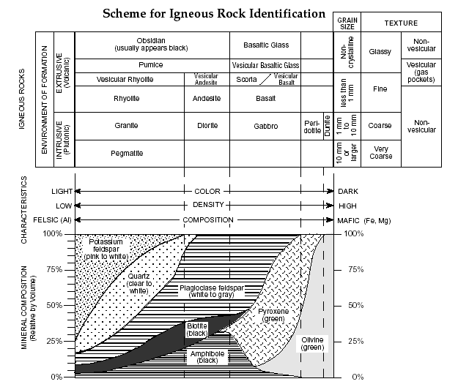

Slide 50
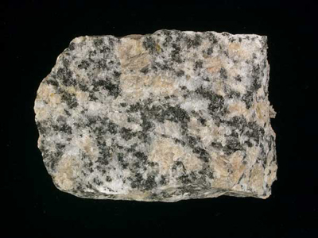
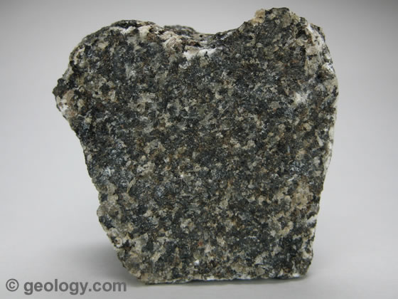
Intrusive Igneous Rocks
Big crystals

Slide 51
Plutonic (inside the earth)
Volcanic (on the surface)
Slow to very slow
Fast to very fast
Large
Small to non-crystalline
Coarse to very coarse
Glassy to fine

Slide 53
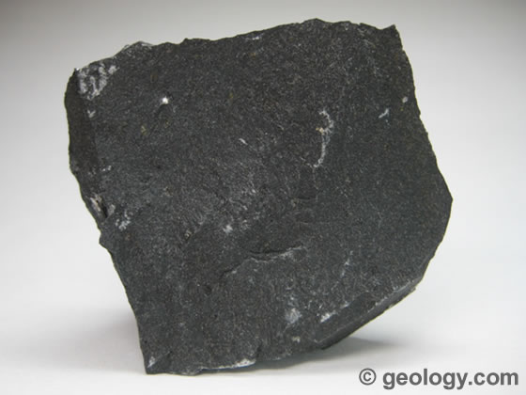
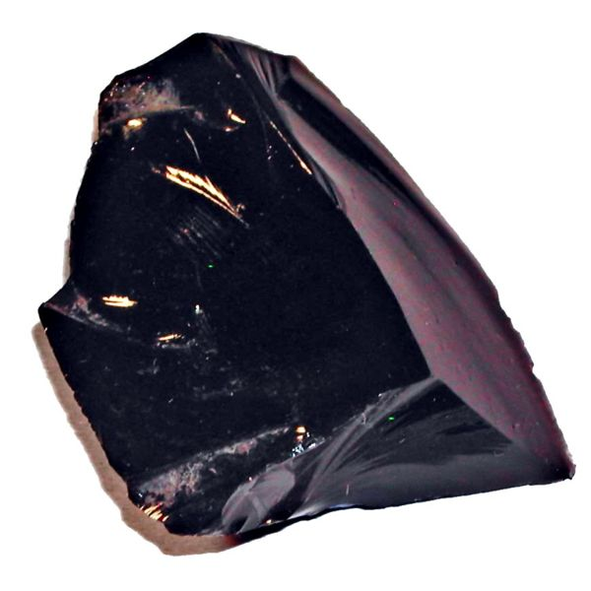
Extrusive Igneous Rocks
Small crystals, or
glassy texture

Slide 54
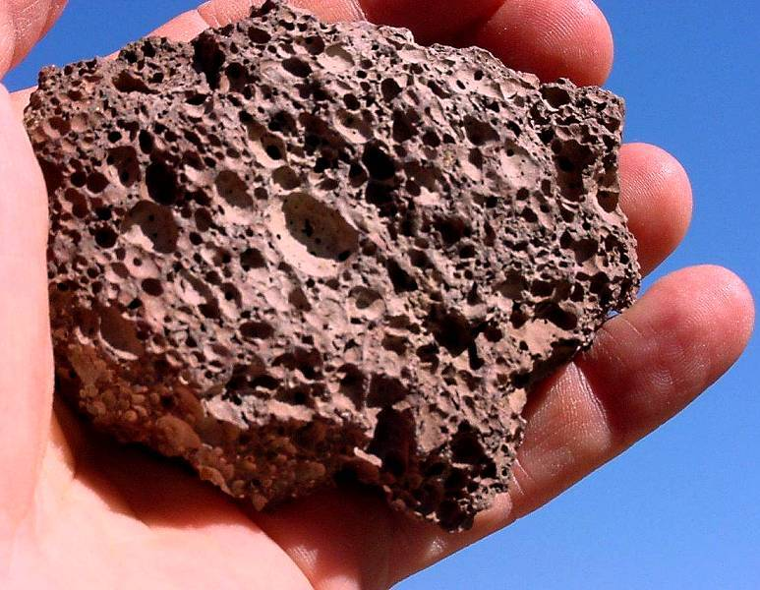
Another identification clue for Igneous Rocks
Vesicular Texture (it has gas pockets)

Slide 55
Complete pages 11-13 in notes packet
Watch You Tube Videos 3.3, ESRT 6b

Slide 56
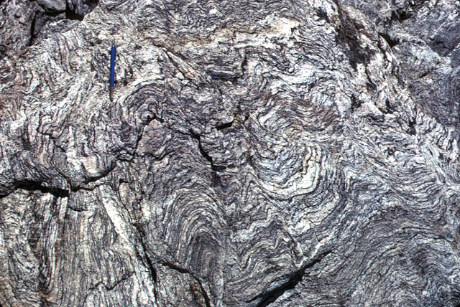
Metamorphic Rocks

Slide 58
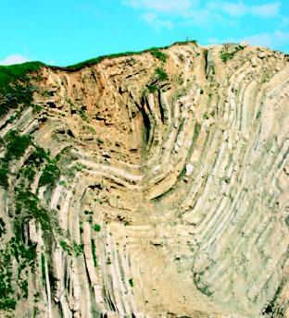
By extreme heat and/or pressure
Mountain forming events

Slide 59
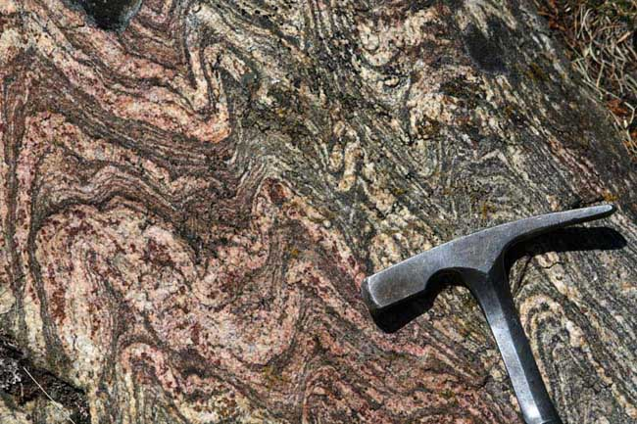
Igneous

Slide 60
- Large areas of rock that undergoes intense heat and pressure.
- Mountain Building Events
- Molten rock comes in contact with surrounding rocks and heat alters it.
* Does not melt the rock

Slide 61
Minerals are aligned
Banding, type of foliation with bands of white and black minerals

Slide 62
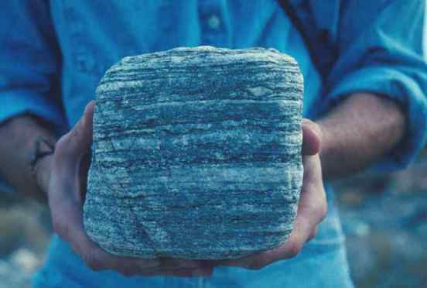

Slide 63
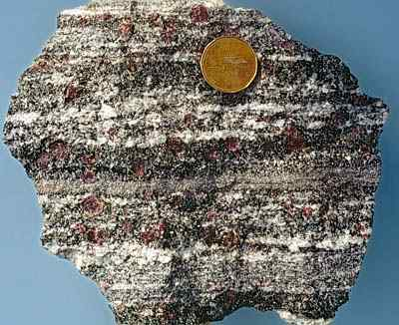

Slide 64
Minerals are aligned
Banding, type of foliation with bands of white and black minerals
Folded Layers

Slide 65
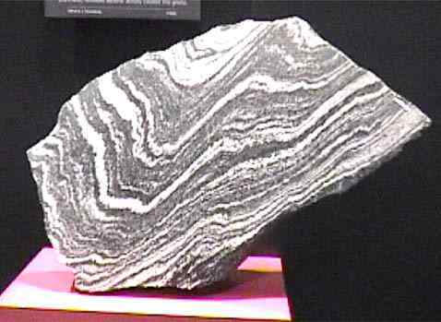

Slide 66
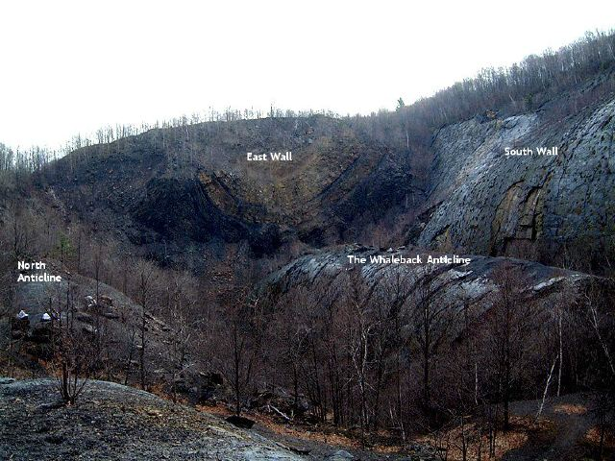

Slide 68
Garnet
Mica

Slide 73
Complete page 15 in notes packet Watch You Tube Videos 3.4, ESRT 7b

